Slide 1
Turning Tracy Using Angles
Notes:
Hi, in this video we’re going to learn how to make Tracy turn in order to complete more advanced challenges.

Slide 2
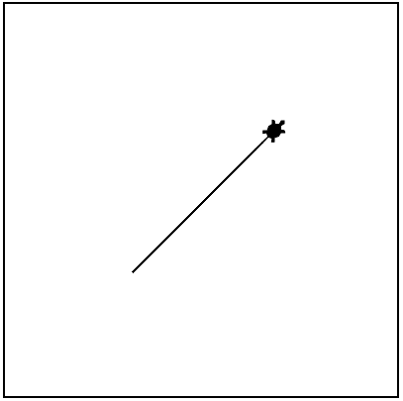
Turning Tracy- Limitations
What if we want Tracy to draw diagonal lines?
Right now, Tracy can only turn at 90 degree angles but we need her to be able to turn at any angle we wish.
Notes:
Right now, Tracy can only turn 90 degrees left or right but what if we want Tracy to draw diagonal lines for us? We need to be able to turn her at any angle we wish.

Slide 3
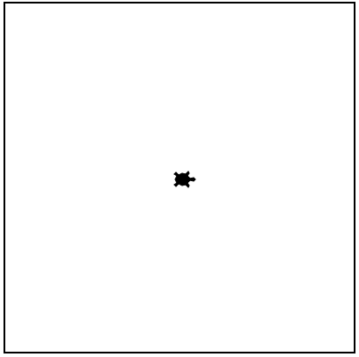

Advanced Turning Commands
left(angle)
right(angle)
Turns Tracy left at a specified angle
Turns Tracy right at a specified angle
left(45)
right(45)
Notes:
Instead of putting a 90 between the parentheses after a left or right command, we can place any angle we want and Tracy will turn that many degrees to the left or right.
Before we jump into writing code using angles, let’s learn a few more commands that will make it easier for us to write more advanced programs.

Slide 4
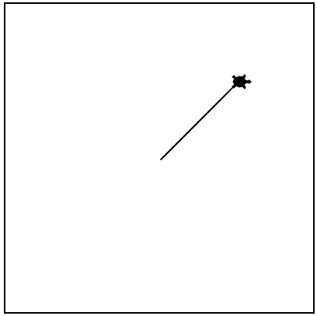
Tracy Command: setposition
setposition(x, y)
Moves Tracy to a specified coordinate
setposition(100,100)
Notes:
We can more immediately move Tracy around the grid world by using the ‘setposition’ command which will have Tracy move directly to that spot in a straight line. If you have not called the ‘penup’ command before using this command, she will leave a trail as she goes from her current position to the position you have called. You will notice that the direction Tracy is facing does not change when you set her position, so if she was facing left before the command was called, she will still be facing left after moving.

Slide 5
Tracy Command: speed
speed(number 0-10)
Sets how quickly Tracy will move through commands
speed(1)
speed(5)
speed(10)
speed(0)
Slowest
Medium
Very Fast
Immediate
Notes:
We have another command that doesn’t have to do with moving Tracy but will make it a lot easier for us to code larger problems. That’s the speed command. You can call this command at the beginning of your code to set the speed for the entire program or call it halfway through to just slow down or speed up a certain section. To use the speed command, you type a number from 0 to 10 into the parentheses. A speed of 1 is the slowest, 10 is very fast, and 0 is almost immediate.
Let’s take a look at how we can use these commands to write some programs.

Slide 6
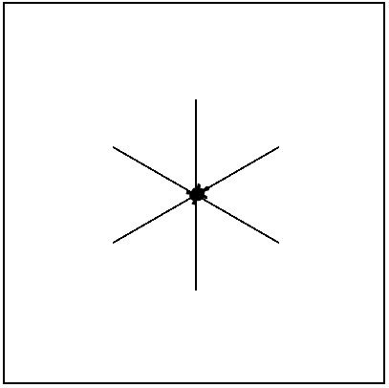
Example #1: Asterisk
Write a program that has Tracy draw an asterisk with lines 100 pixels long.
Notes:
In our first example, we want Tracy to draw an asterisk from the center of the canvas.

Slide 7
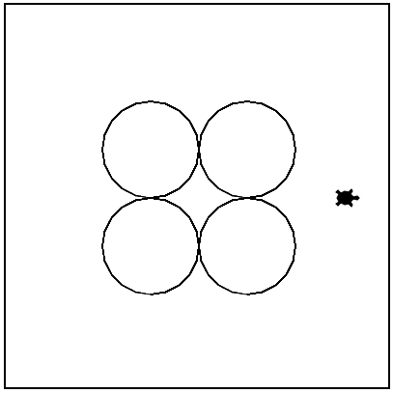
Example #2: Four Circles
Write a program that has Tracy draw four circles at the center of the canvas.
Notes:
Let’s look at a more advanced example now. In this challenge, we want Tracy to draw four circles that are centered on the canvas. We are going to have a lot of challenges that ask us to center our drawings so it is important to take some time to plan exactly how we can make this happen.

Slide 8
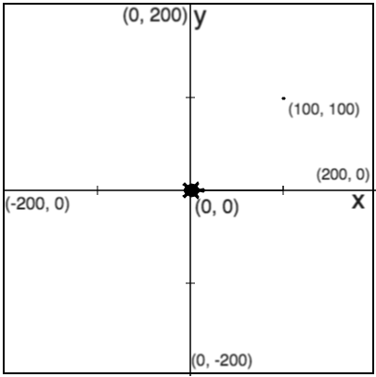
Example #2: Four Circles
Notes:
2 x radius = diameter
Notes:
Our circles are going to have a radii of 50 and there is going to be one drawn in each quadrant of the canvas. It is important to remember that (click for label and red line) the radius is the distance from the center of a circle. The entire length of the circle is 2 x radius or the diameter.

Slide 9
Example #2: Four Circles
Notes:
2 x radius = diameter
Bottom row starting position: (-50,-100)
Notes:
It is also important to note that Tracy always draws circles starting from the bottom. So in order to have her draw the bottom left circle, we need to situate her here (Click for red x). This coordinate has an x-value of -50 and a y-value of -100 (Click for label).

Slide 10
Example #2: Four Circles
Notes:
2 x radius = diameter
Bottom row starting position: (-50,-100)
Distance between circles: 100
Notes:
Once Tracy draws this circle, we’re going to want her to move forward to draw the next circle in the bottom right position. She is going to need to move (Click for red line and label) forward 100 pixels, which is the diameter of each circle, to get to the bottom of the next circle.

Slide 11
Example #2: Four Circles
Notes:
2 x radius = diameter
Bottom row starting position: (-50,-100)
Distance between circles: 100
Top row starting position: (-50, 0)
Notes:
The last thing we need to make note of is where Tracy needs to move to after she draws the bottom row of circles. (Click for red x) Here is where she needs to be to draw the top row, which is at position (Click for label) (-50, 0).
Now we’re ready to get coding.

Slide 12
Commands Learned this Lesson
Command | What does it do?
left(angle) | Turns Tracy left at a specified angle
right(angle) | Turns Tracy right at a specified angle
setposition(x, y) | Moves Tracy to a specified coordinate
speed(number 0-10) | Determines how quickly Tracy will move through commands
Notes:
In this lesson, we learned how to use angles in the left and right commands and how to use the setposition command to send Tracy directly to a specific coordinate point. We also learned how we can use the speed command to monitor how quickly Tracy completes the command we give her. Now it’s your turn to use these new commands to solve Tracy exercises.

